Slide 1

ACE ENGINEERING COLLEGE An Autonomus Institution
Language Translator Using React js
GUIDE :
Mrs. Kamakshi thai
By :
G.Dinesh 22AG1A6624

Slide 2
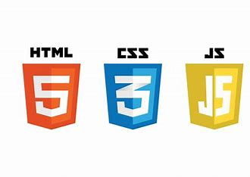

Introduction
Unlocking Communication: Building a Language Translator with React.js
Translator is a web application software tool that facilitate the translation of text from one language to another language using ReactJS. Enables communication between speakers of different languages, facilitating global interaction and understanding.
Leveraging the power of modern web technologies, particularly React.js, we embarked on the journey of creating a language translator application. Our goal was to design a user-friendly and efficient tool that would enable individuals to translate text between different languages with ease.
In conclusion, our journey to develop a language translator application using React.js has been both challenging and rewarding. By harnessing the power of technology, we've created a tool that has the potential to break down language barriers and foster meaningful connections across cultures. As we continue to refine and enhance our project, we remain committed to empowering individuals to communicate effortlessly in a multilingual world.
Prerequisites and Technologies:
ReactJS
HTML
CSS
Functional Components in React

Slide 3
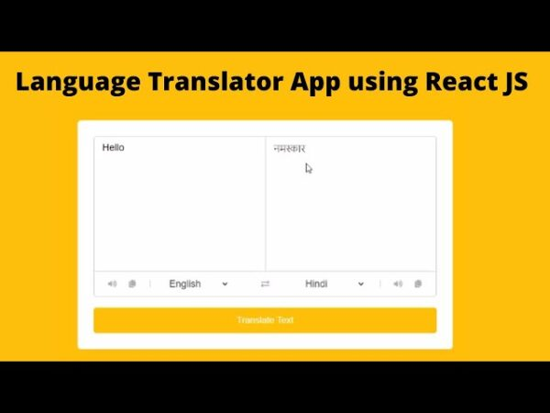
ABSTRACT
Translator is a web application software tool that facilitate the translation of text from one language to another language using ReactJS. This application allows users to give input Text and select input and output language Format from the list of languages and uses Microsoft Translator API.
Users can also reverse the source and target languages and clear the input text. The component provides a user-friendly interface for language translation, with dynamic updates and error handling. This application is implemented using ReactJS and has a simple and responsive UI.
This project basically implements functional components and manages states. This application uses the Microsoft Translator API for language translation, making POST requests with the input text and language preferences. Upon receiving the response, the translated text is updated in the component’s state, and loading spinners are displayed during the API call.
The component’s interface allows users to select languages, input text, translate, and reverse language selection. If API call is rejected then it shows an error message during translation.

Slide 4
ADVANTAGES
When you’re talking to people from another country whose language you don’t understand, it helps to have someone on one hand who can act as an interpreter.
Language translators are trained to speak and translate from one language to another fluently, and with ease. If they’re well-qualified, you can be assured that your messages will be properly interpreted and won’t suffer from any accidental mis-communications.

Slide 5
Disadvantage
Translation demands a deep understanding of both grammar and culture. Translators need to know the rules of a language as well as the habits of the people who speak it. And even for the most experienced professionals, confusion and frustration are familiar feelings. familiar feelings.

Slide 6
Thank you

